Slide 1
Update: Virtual Law Office Johan LAMBERS & Anna SUSSAROVA from iustica.BE 23.06.2010 5th CIS FORUM Minsk

Slide 2
TOPICS
Presentation of iustica.BE
Generally: the virtual office
Required skills
Equipment investments for the virtual office
File management within the virtual office
Practice management with the virtual office
Results
Conclusions
Notes:
2

Slide 3
1. Presentation of iustica.BE
Team of 8 lawyers, specialized by language and by field of law :
Dutch, French, English, German and Russian
Corporate and Associations, Commercial Law, Labour Law, International Private Law
Working mostly in team on the files
Only one administrative employee
iustica.BE
Notes:
3

Slide 4
1. Presentation of iustica.BE
International SME clientèle :
Notes:
4

Slide 5
1. Presentation of iustica.BE
Mostly through referrals :
iustica.BE
Notes:
5

Slide 6
EXPECTATIONS FOR THE FUTURE
Notes:
6

Slide 7
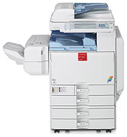
2. IN GENERAL: VIRTUAL OFFICE = PAPERLESS
Paperless file management
Paperless know-how:
Free online sources: searches (Google), government websites (Moniteur), dictionaries (www.granddictionaire.com, www.wordreference.com, …)
Online with charges : LexisNexis, Jura, Strada, …
CDs available individually or through the server: dictionaries, forms (Bijvoorbeeld, BECK‘s compendium of forms,…)
Office-wide database (know how sharing and management)

Slide 8
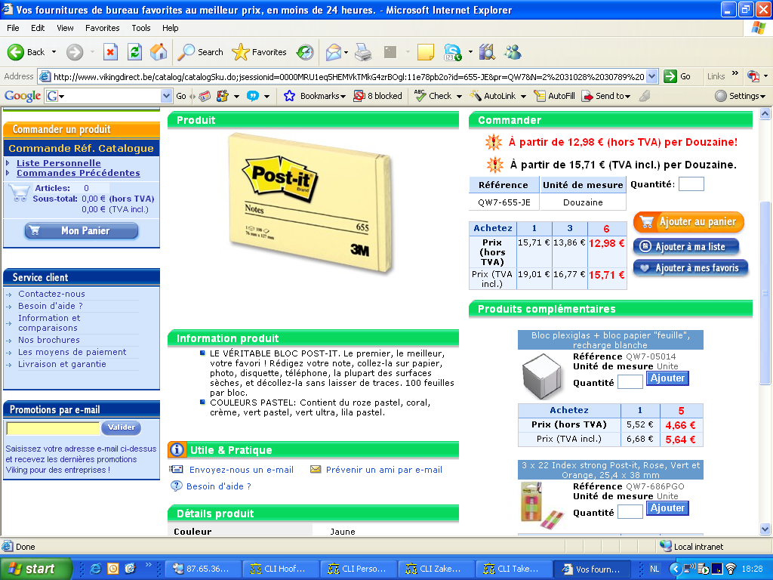

Slide 9
2. IN GENERAL: VIRTUAL OFFICE = PAPERLESS
Limits of paperless file management:
Originals / back-up copies; archives
Information unavailable online (paper editions of doctrine, etc.)
Attempts to avoid these limits:
Documents with digital signature = original documents
Electronic archives
Online books and databanks are more and more developed

Slide 10
3. REQUIRED SKILLS
Experience with computers
Experience with standard software such as Microsoft Office: Word, Excel, Outlook, Powerpoint, …
Experience with law practice management software
Experience with paperless communication

Slide 11
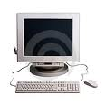
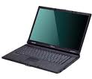
HARDWARE
SOFTWARE
Notes:
В начале

Slide 12
SOFTWARE EXAMPLE : WORD
SOFTWARE ESPECIALLY DEVELOPPED FOR LAWYERS ANNUAL

Slide 13
EXCPECTATIONS FOR THE EQUIPMENT
work with standardized software (ex: MICROSOFT) which allows paperless management of the office
avoid investements (€10’000 / 8 persons / year) in specialised software especially developped for legal offices

Slide 14
4. FILE MANAGEMENT WITHIN THE VIRTUAL OFFICE
Data management
Managing documents
Three steps procedure

Slide 15
4.1. Data management
Database including all contacts (client, opponents, colleagues, third parties, ...), verification of conflicts of interest
Database with files (per client, per case matter, …)
Database with performances (classified per “dominus litis„, per performer, per form, per client,…)

Slide 16
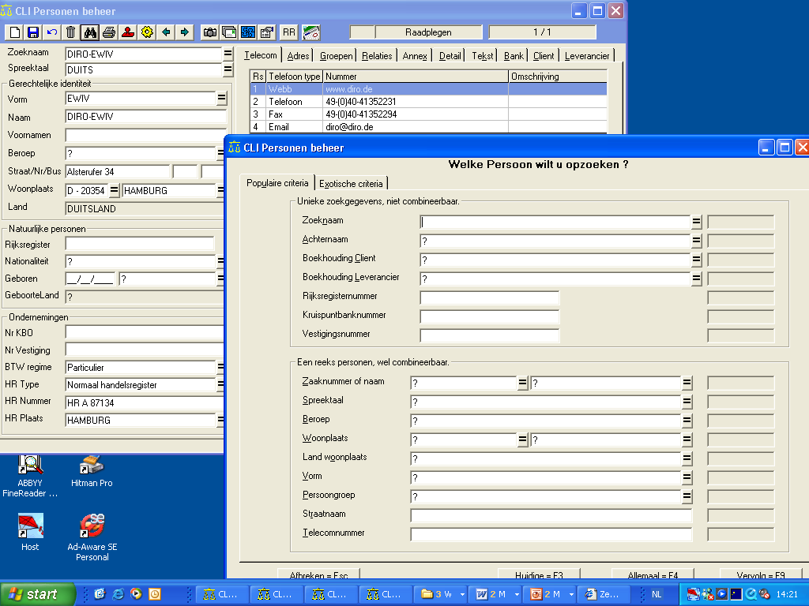
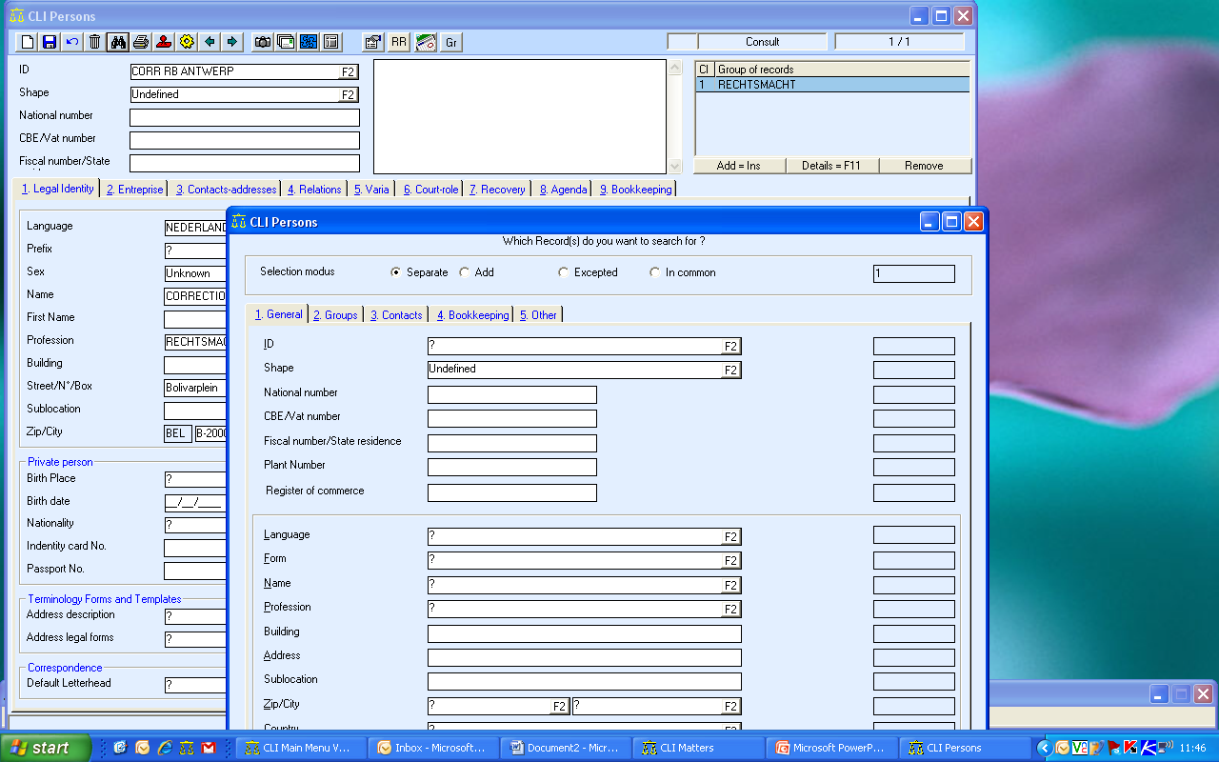

Slide 17
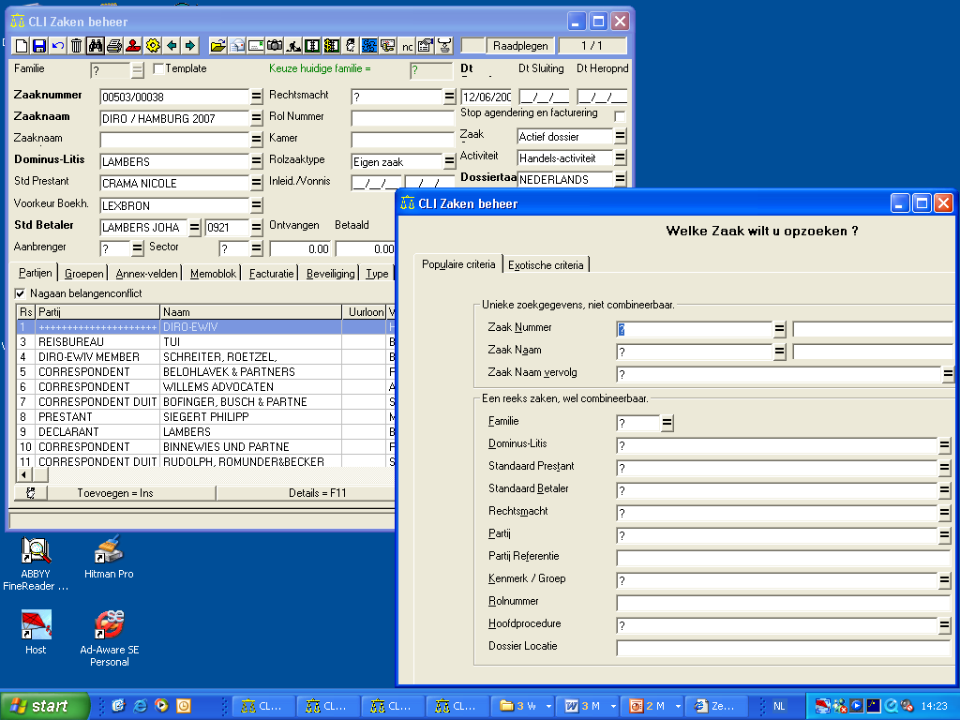
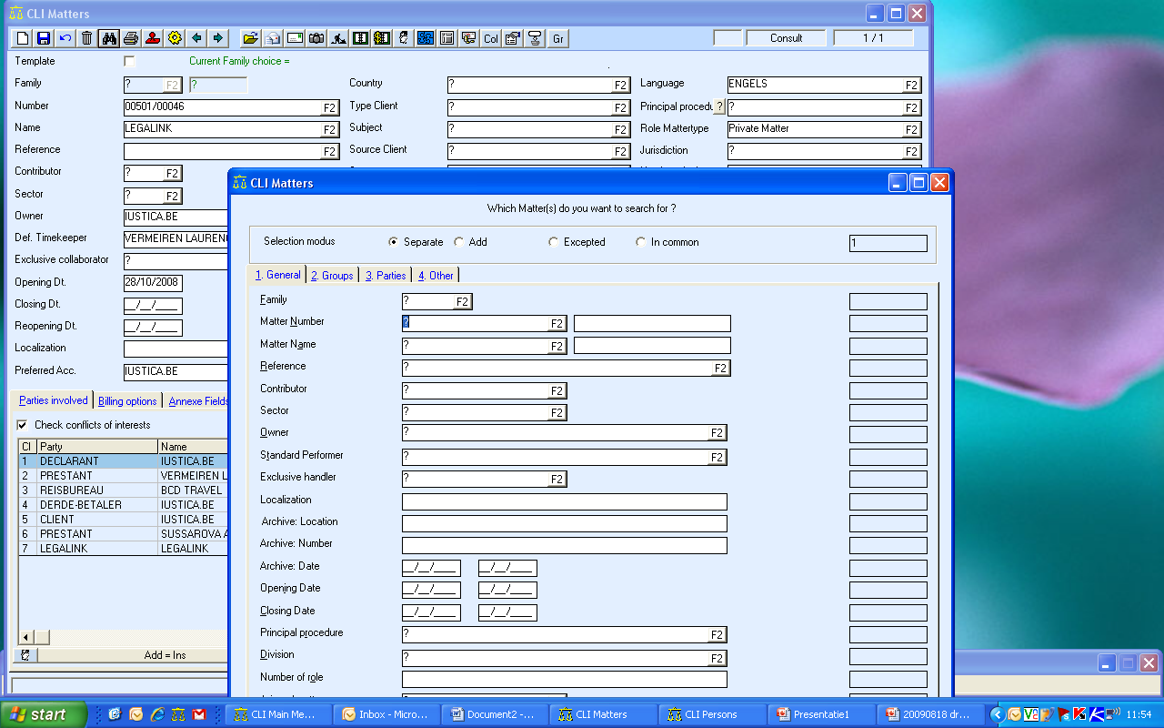

Slide 18
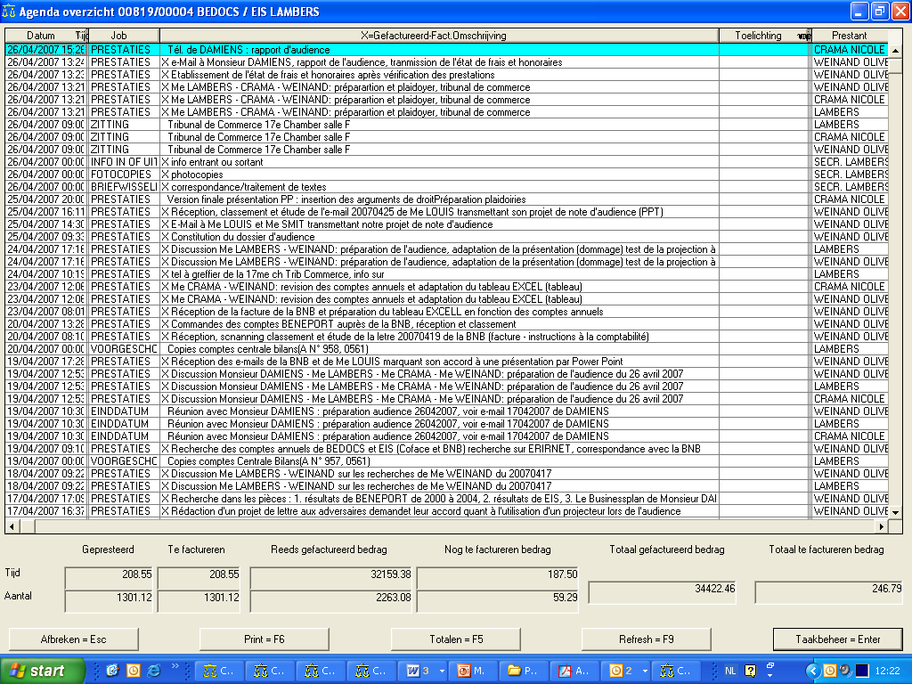
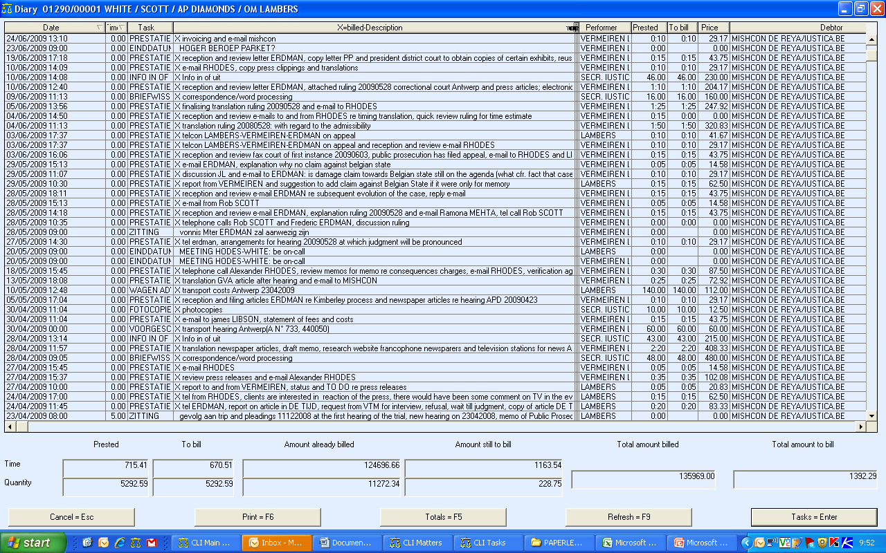

Slide 19
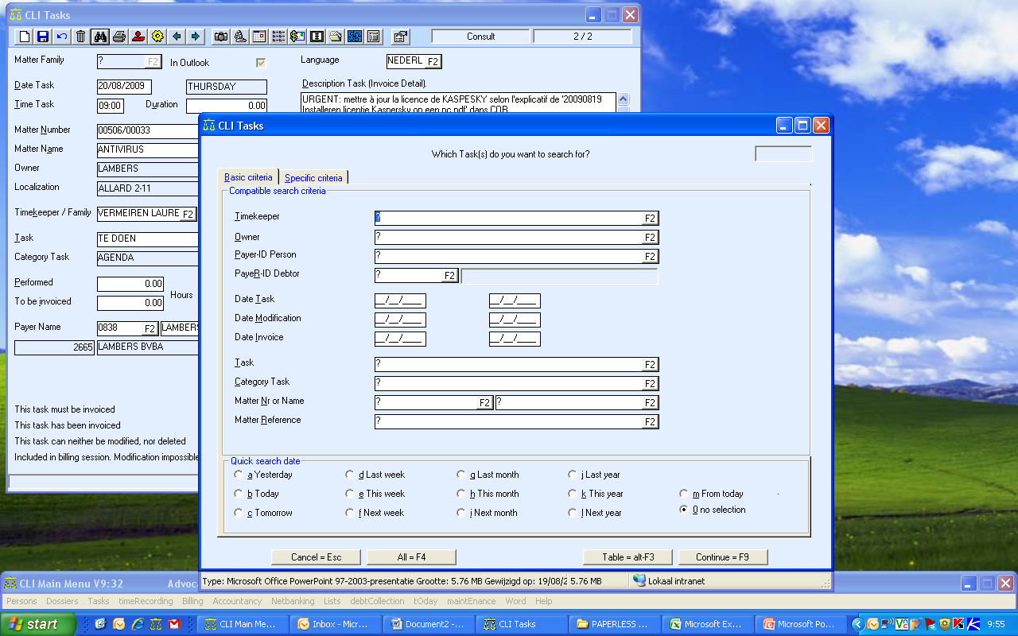
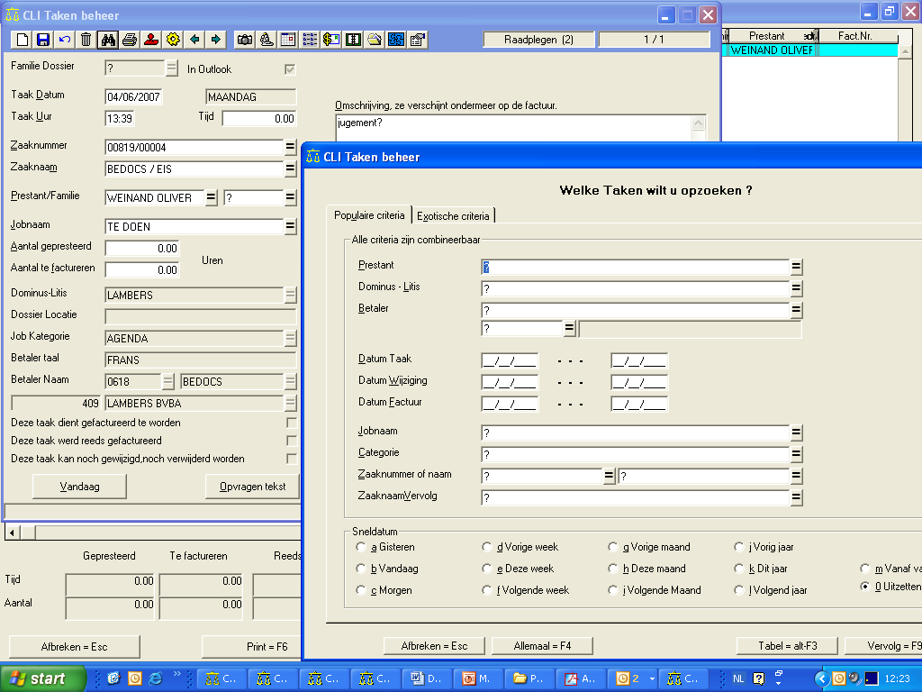
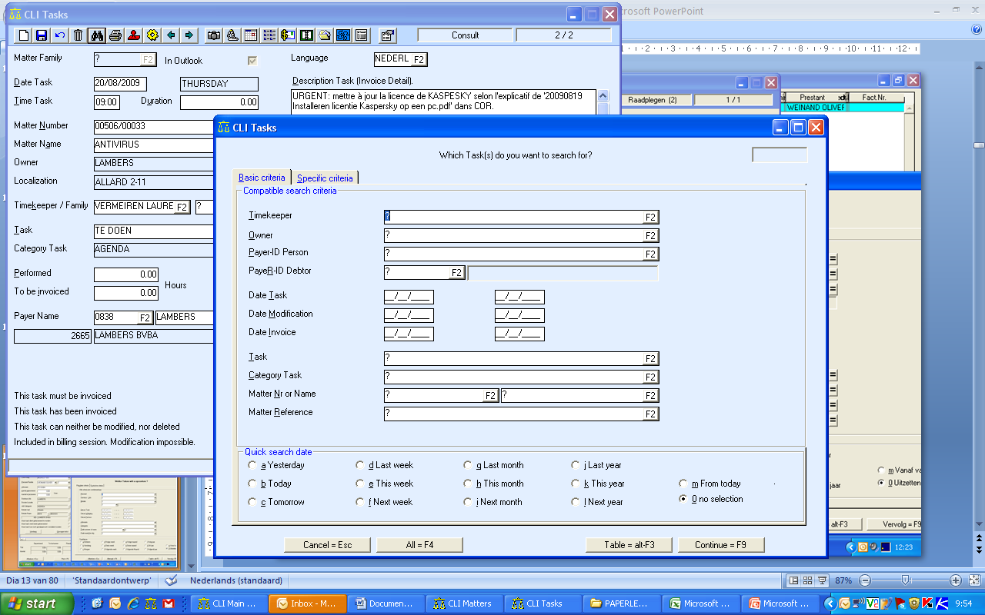

Slide 20
4.2. Managing documents
Confidential correspondence / negotiations
Confidential documents
Research (jurisprudence, doctrine)
Trial exhibits
Trial exhibits of other parties
Procedure
Extrajudicial negotiations
Finances: invoices from and to the law practice
Finances: third party accounts

Slide 21
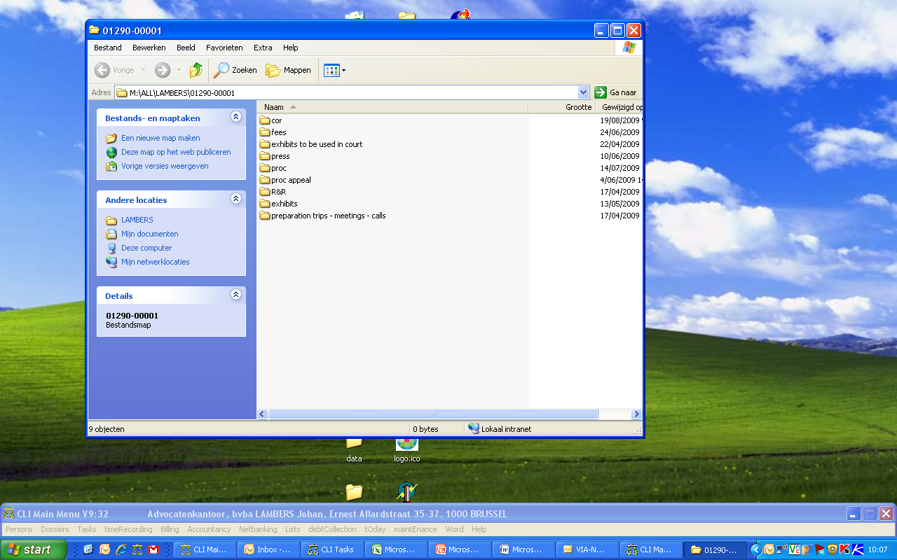
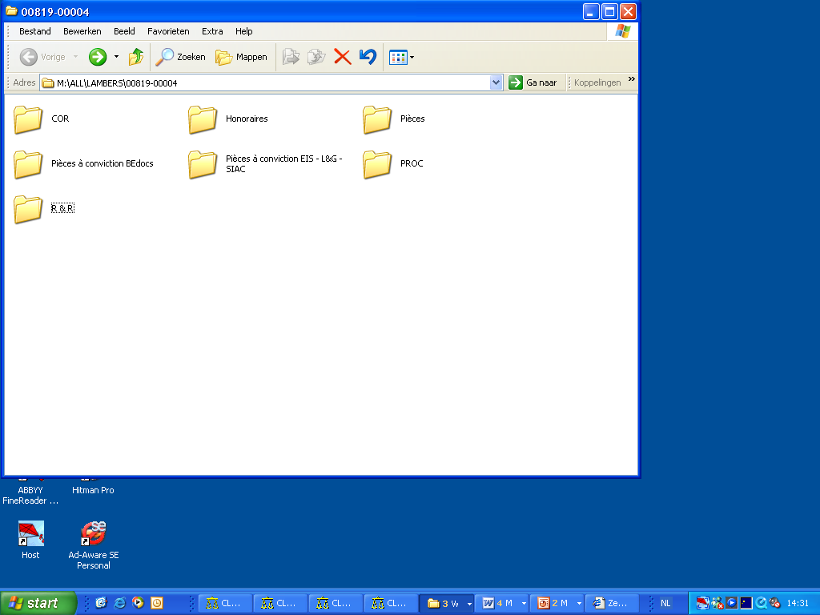

Slide 22
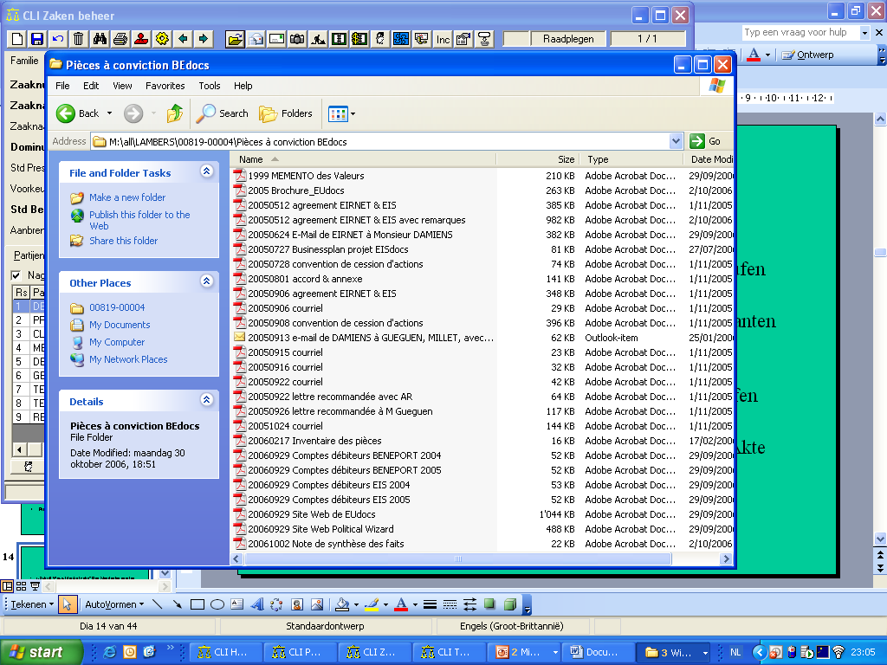
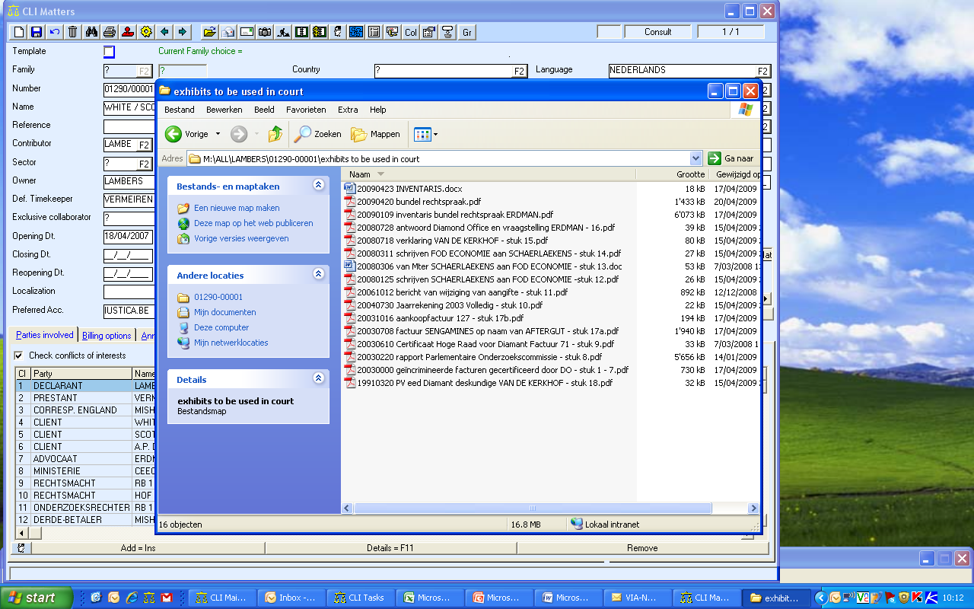

Slide 23
4.3. Three-step procedure
First step: Task to do on the agenda. EX.: Call the client
Second step: Implementation of task. EX.: I call the client
Third step: Next task. EX.: agreement on meeting with the client
Then
First step: Task to do on the agenda. EX: Meet the client
Second step: Implementation of the task. EX.: meeting with the client and agreement to represent his interests
Third step: Next Task. EX.: Opening of a new file
Then…
Notes:
23

Slide 24
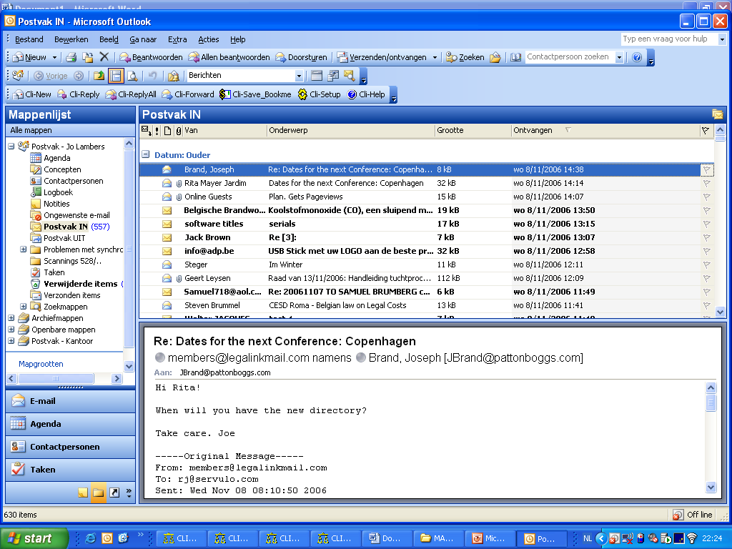
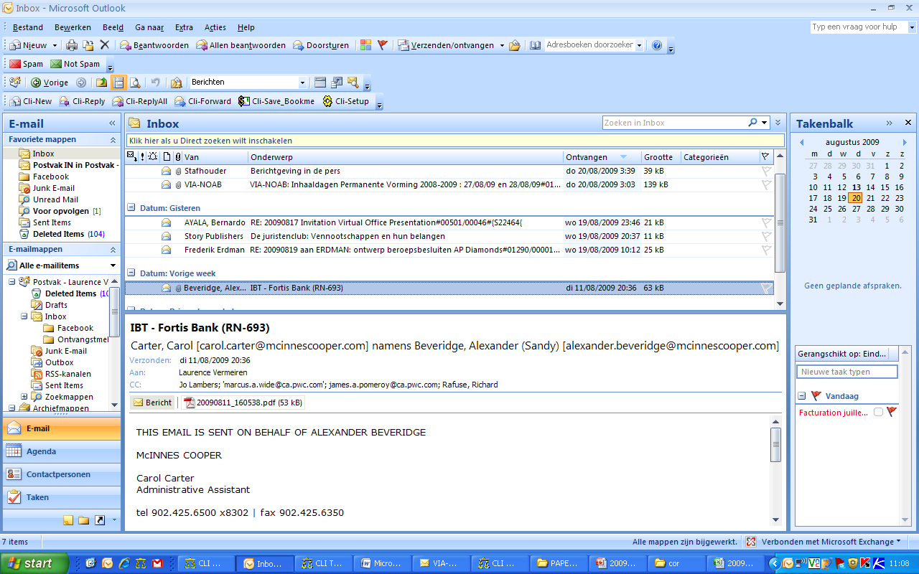

Slide 25
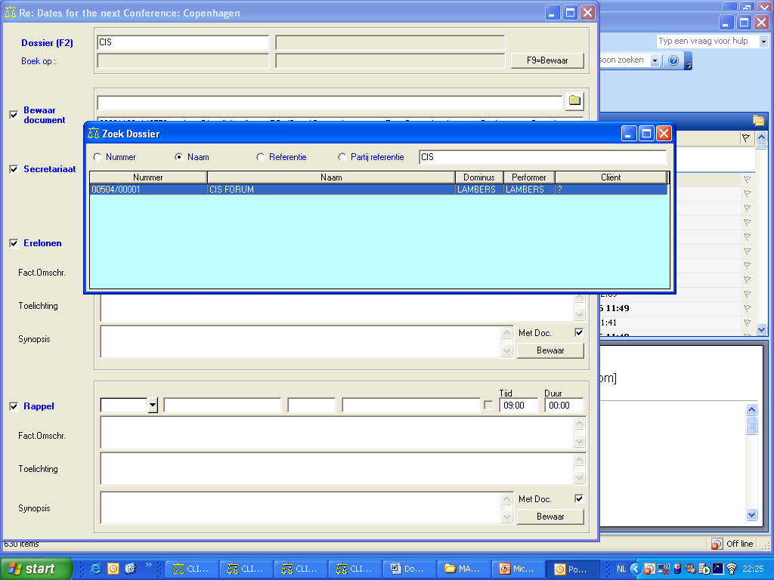
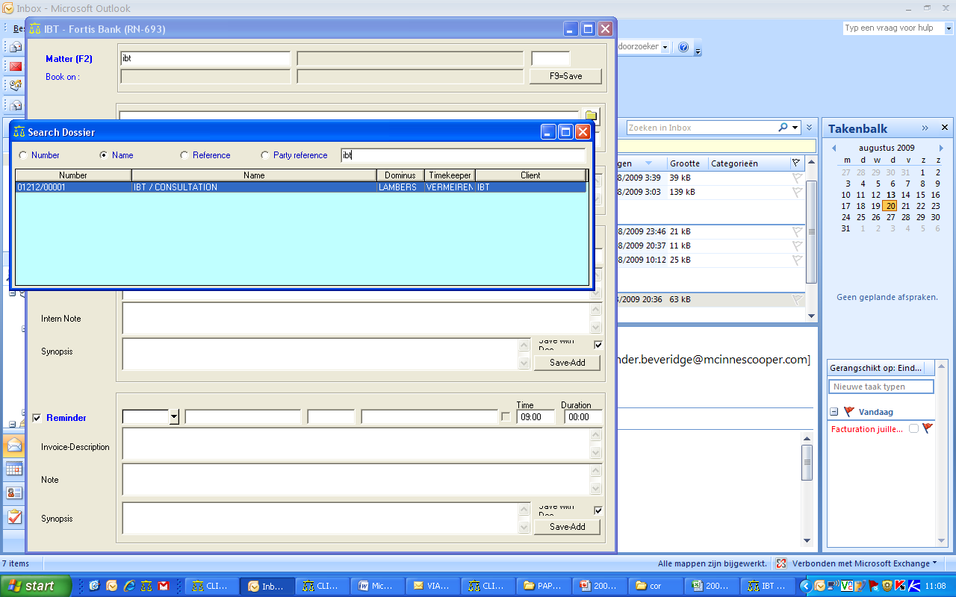

Slide 26
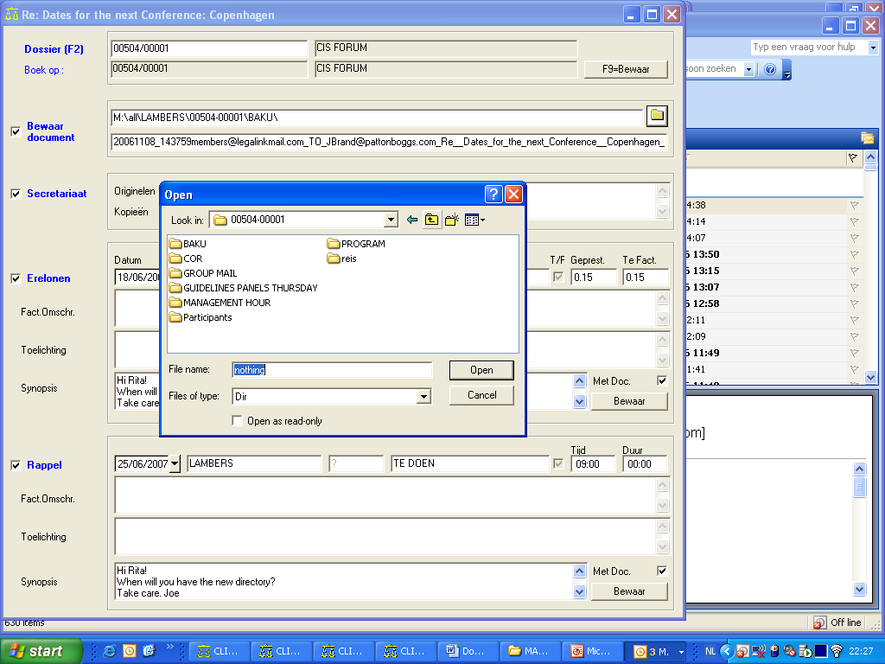
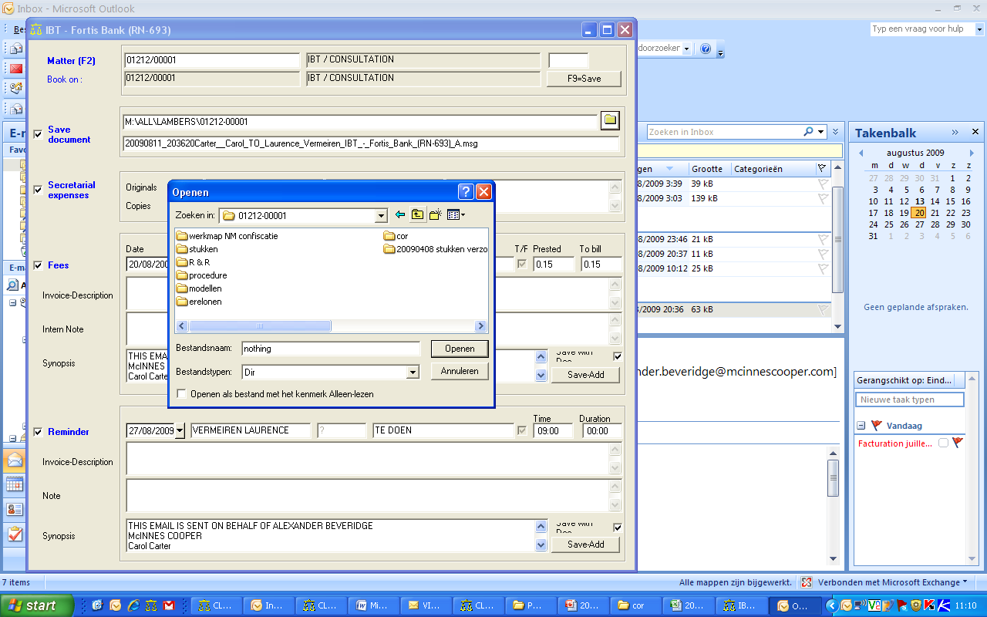

Slide 27
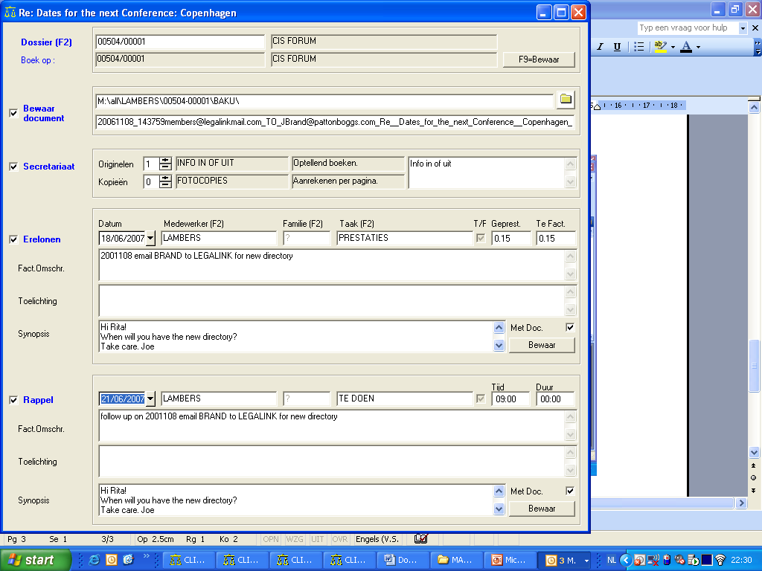
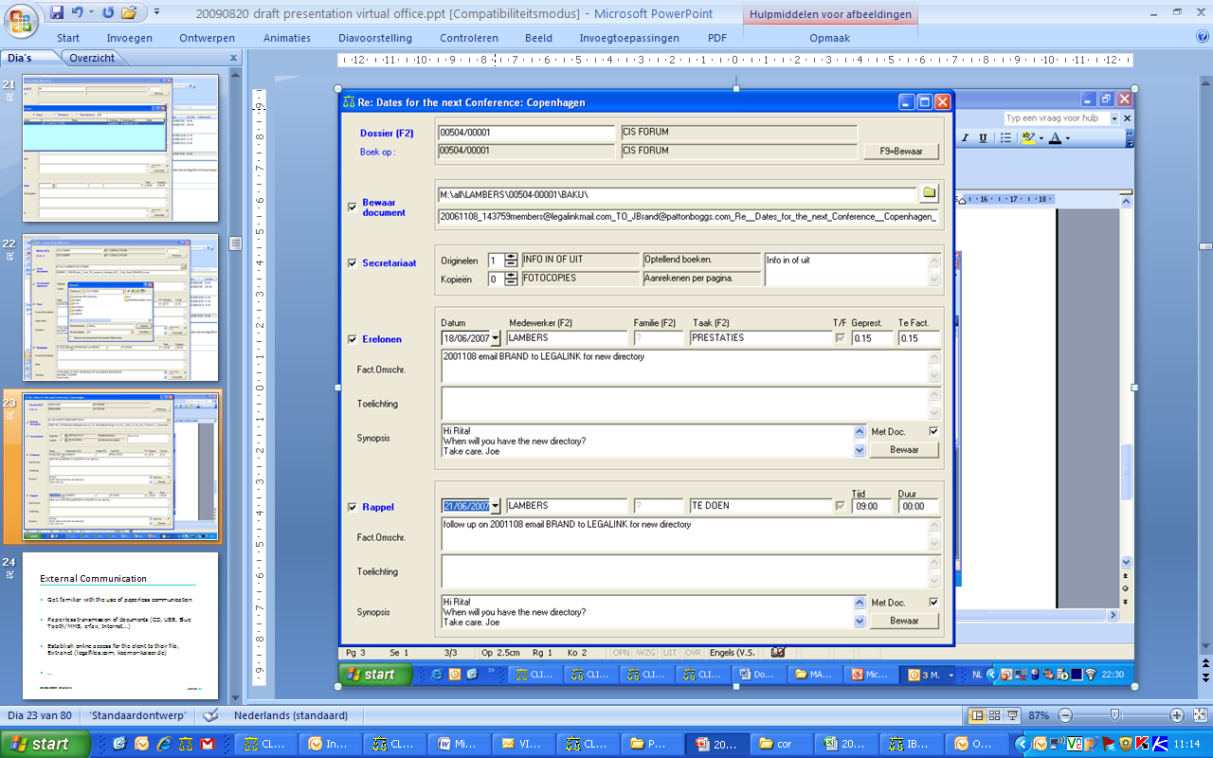
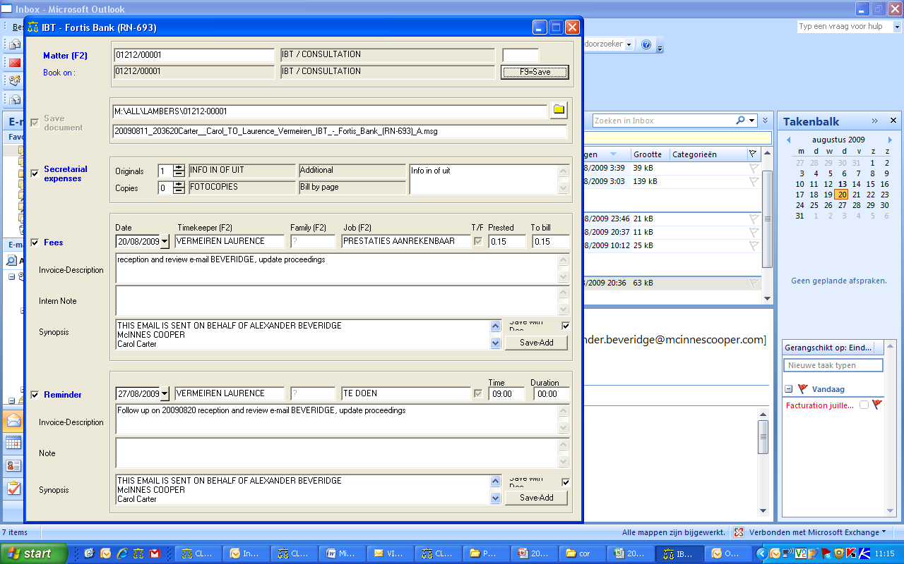

Slide 28
5. VIRTUAL LAW PRACTICE MANAGEMENT
Staff management
Finances
IT-administration
Continuing education
PR and Marketing

Slide 29
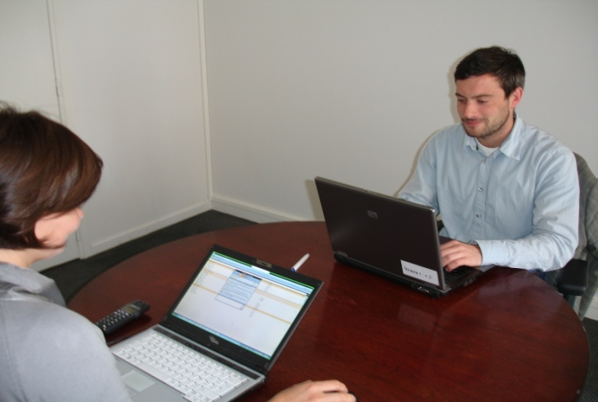
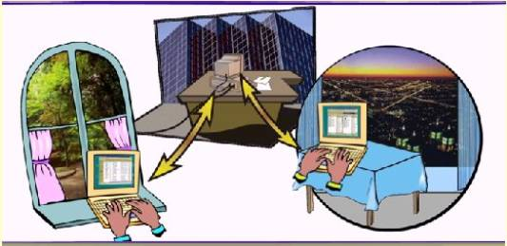
5.1. Staff management
Working from home
Mobile working → office anywhere on the planet, even in the sky

Slide 30
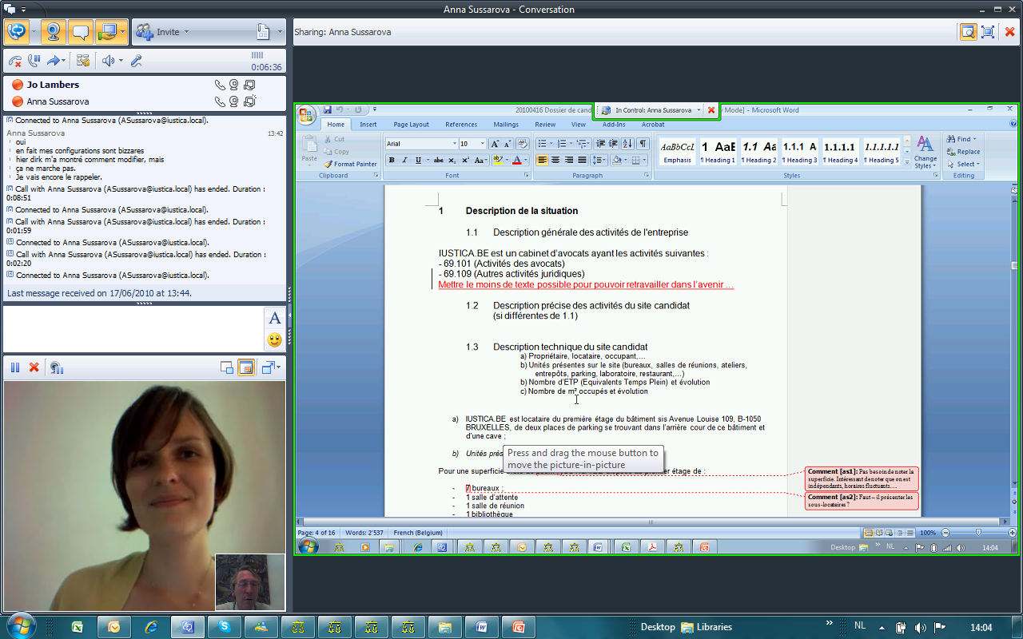

Slide 31
5.2. Finances
Planning
Complete Accounting
Internal controlling

Slide 32
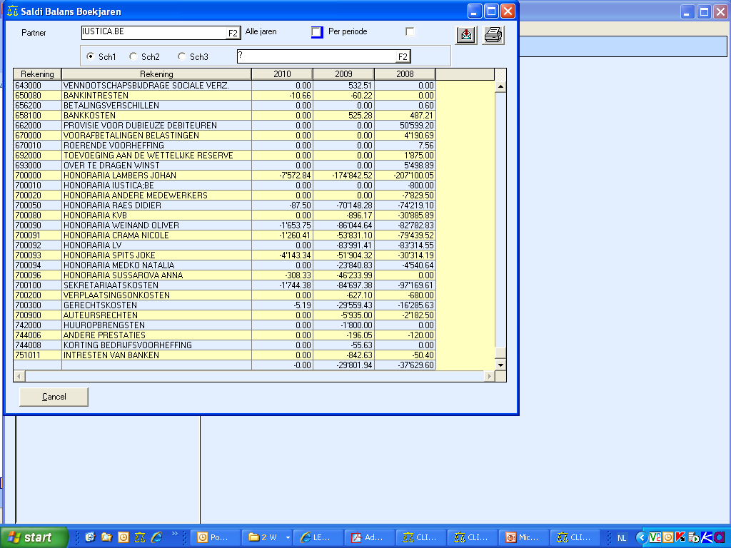
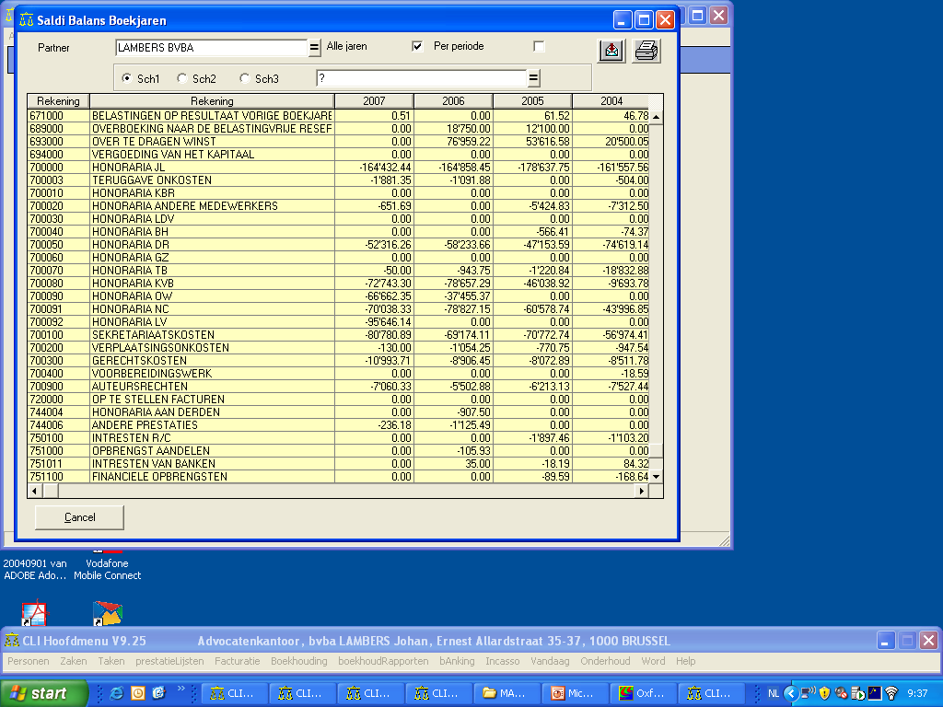
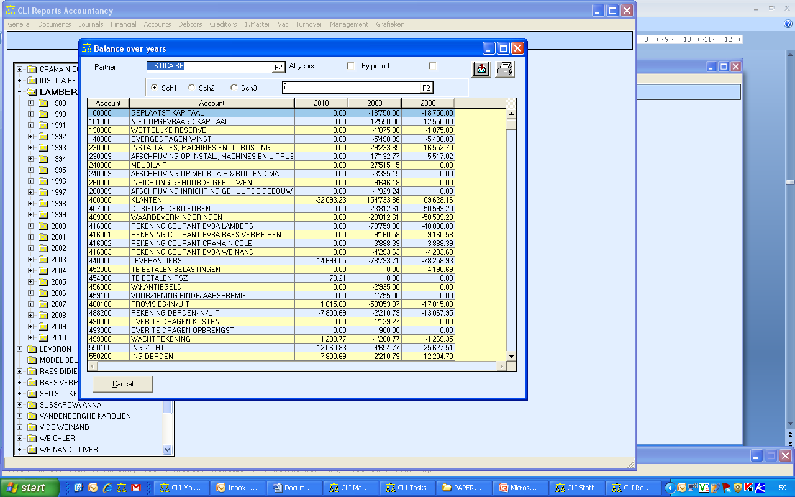

Slide 33
5.3. IT-administration
Loose fear and scepticism of IT-devices
Help and guidance through IT professionals
Continuing improvement and upgrading of programmes through feedback from lawyers to programmers
PASSWORD Management
BACK UP Management
VIRUS Management

Slide 34
5.4. Continuous Learning
User‘s manual (know how sharing and management)
Online-library
Management of knowledge / know-how

Slide 35
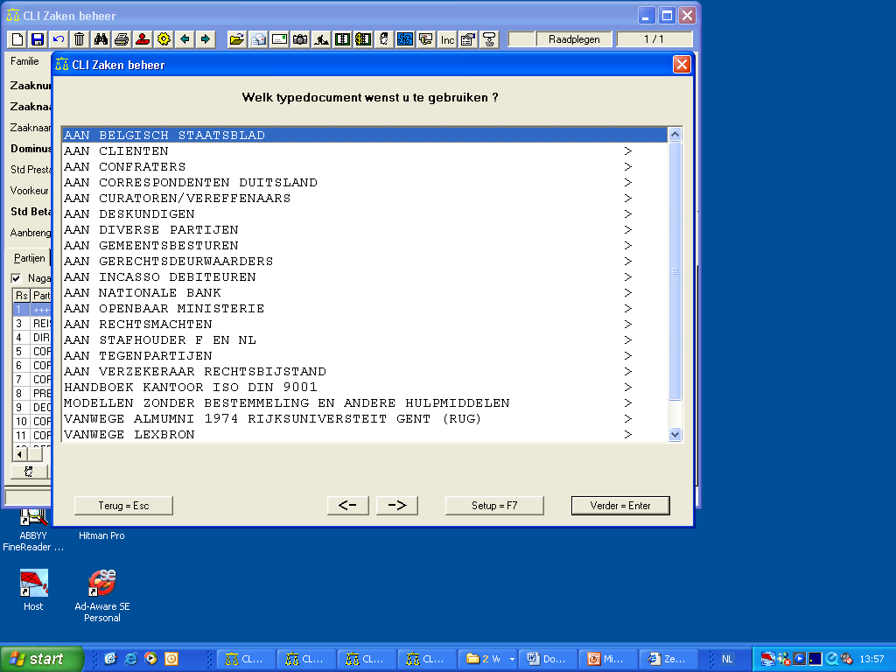
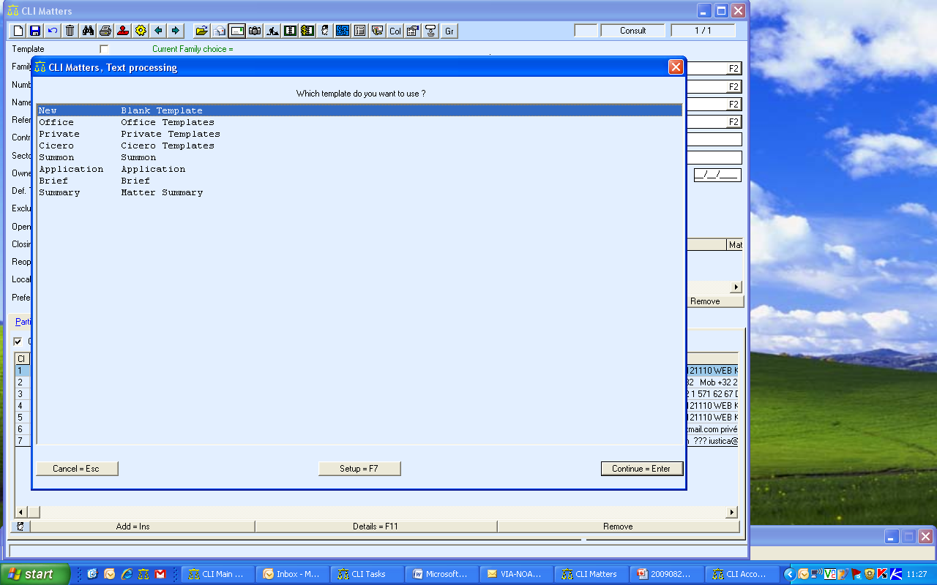

Slide 36
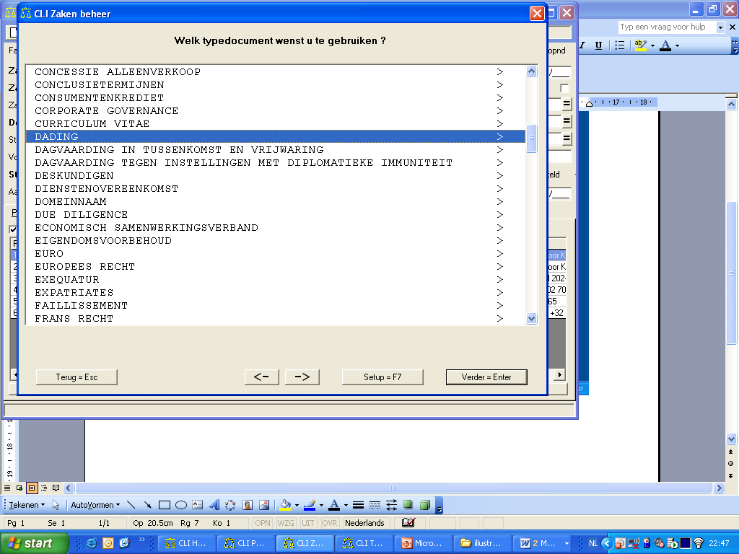
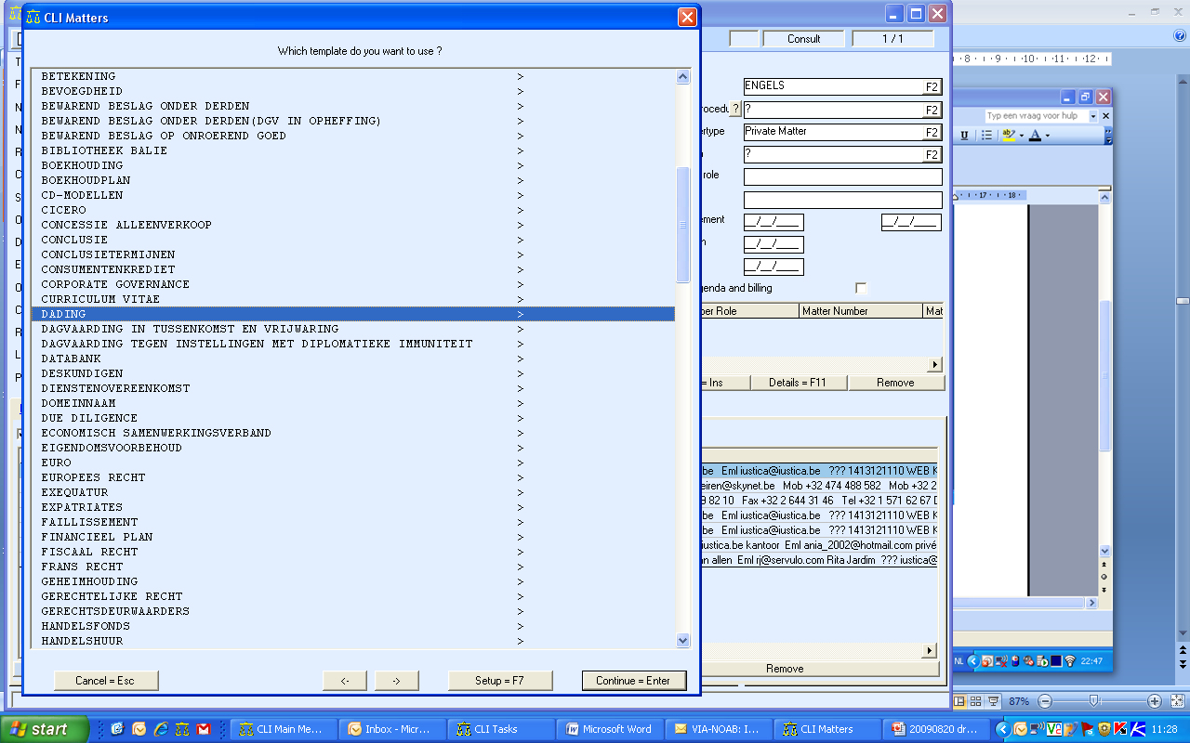

Slide 37
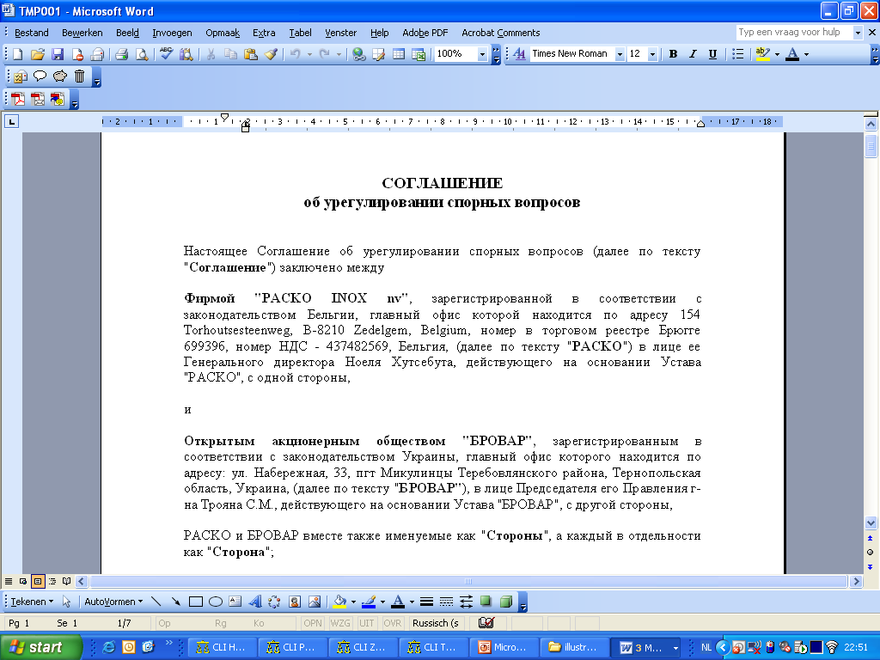
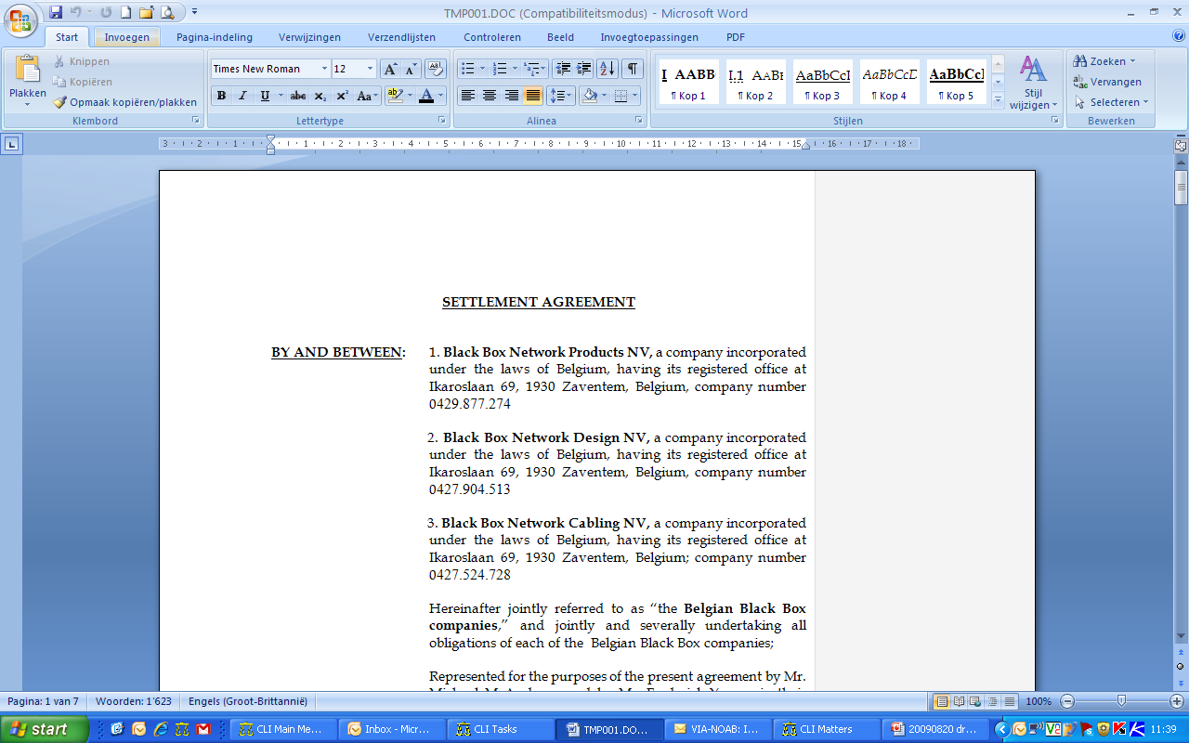

Slide 38
5.5. PR and Marketing
Website as means of representation
Advertising on the internet
Participation in virtual networks, conferences and seminars
Internet search of customer markets

Slide 39
6. RESULTS
File management
Communication
Law Practice management

Slide 40
6.1. Results : file management
Improved draft management
Improved data management
Improved time management
More efficient research
Exact accounting for time spent
Improved cost forecasting for the client

Slide 41
Improved draft management
files saved under different names (versions) as often as necessary, possibility to retrace evolution of discussions / negociations / preparations

Slide 42
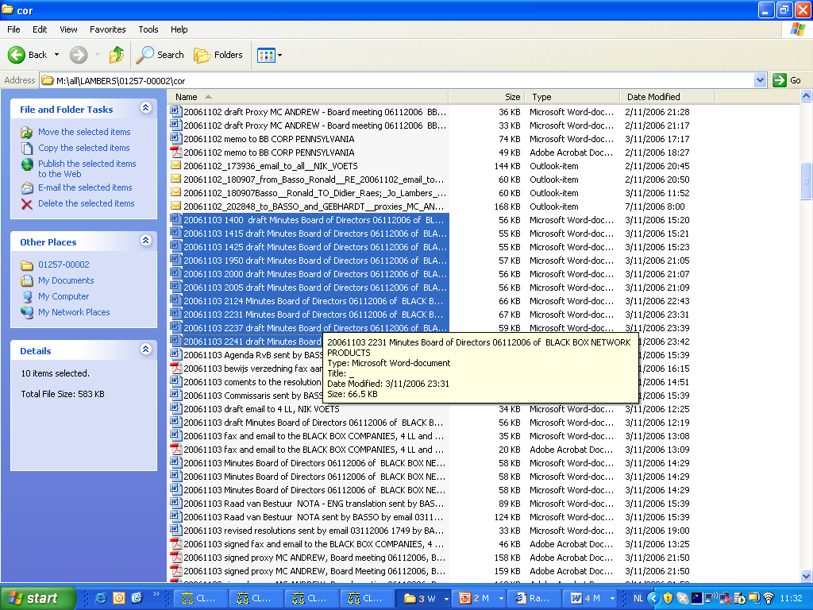

Slide 43
Improved data management

Slide 44
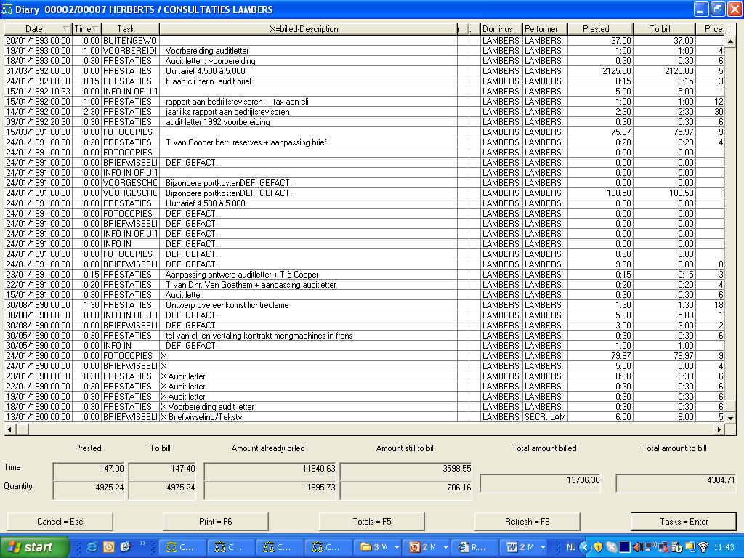

Slide 45
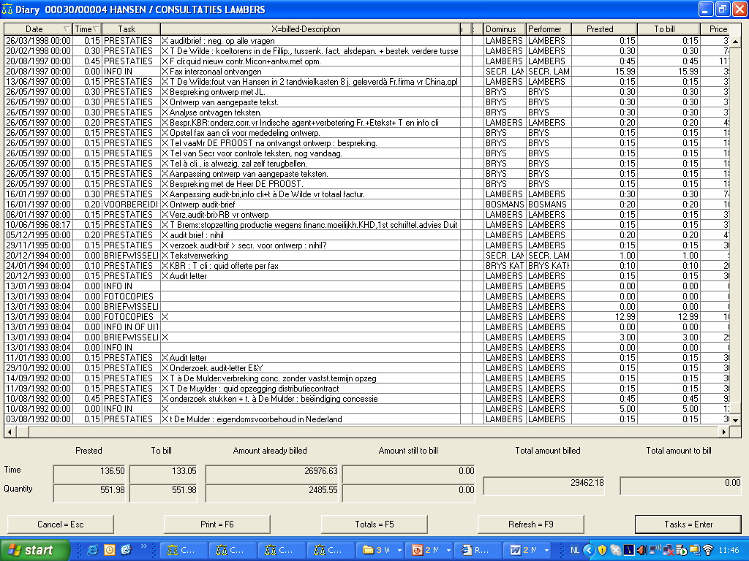

Slide 46
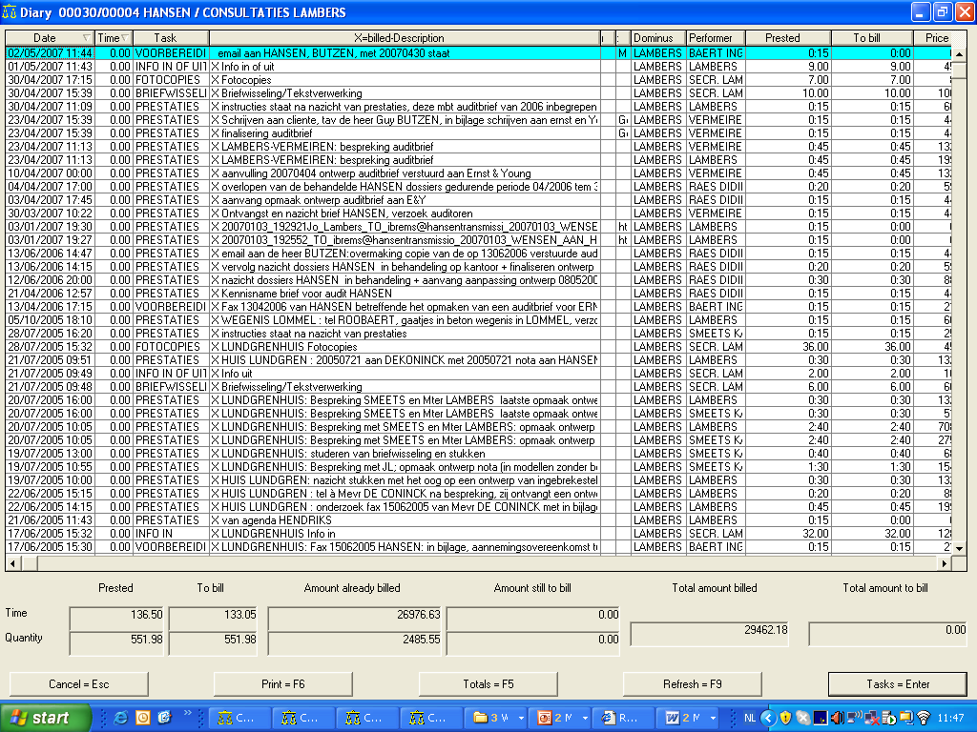

Slide 47
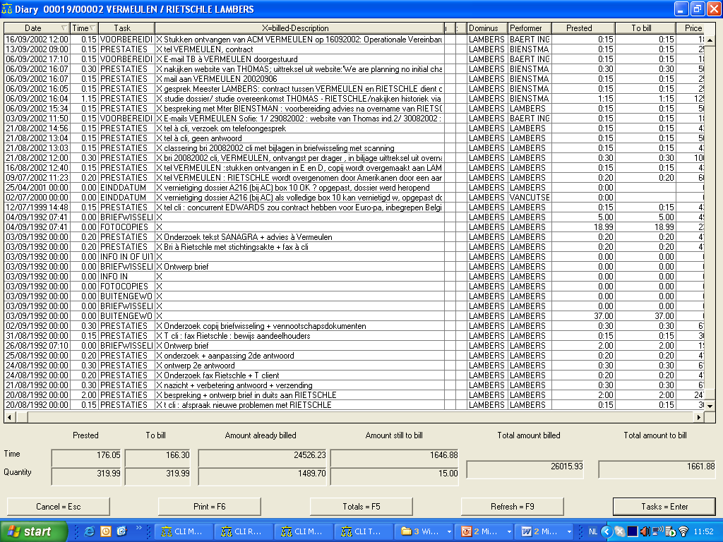

Slide 48
Improved time management
Introduction of dates in a far future, shared agenda

Slide 49
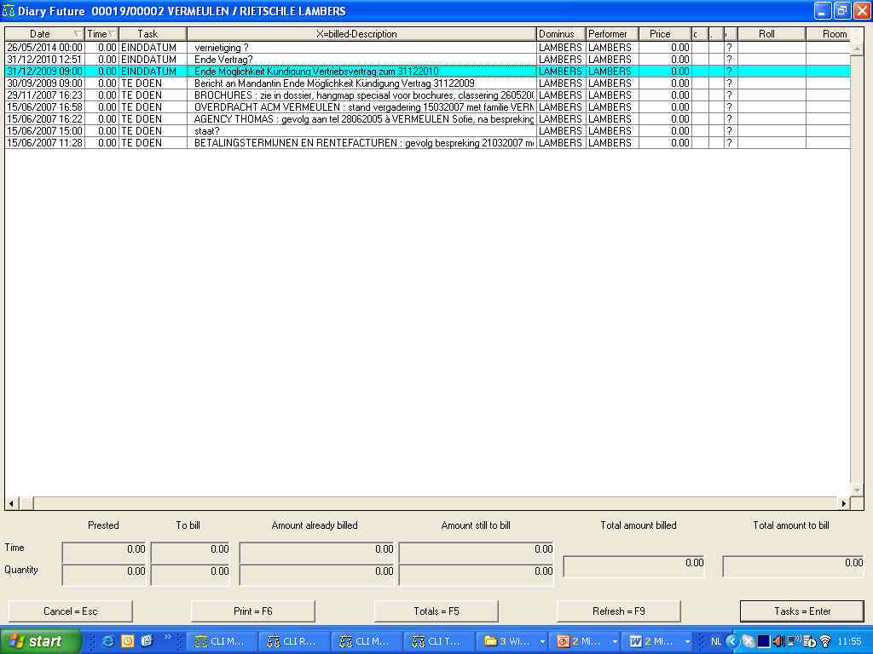

Slide 50
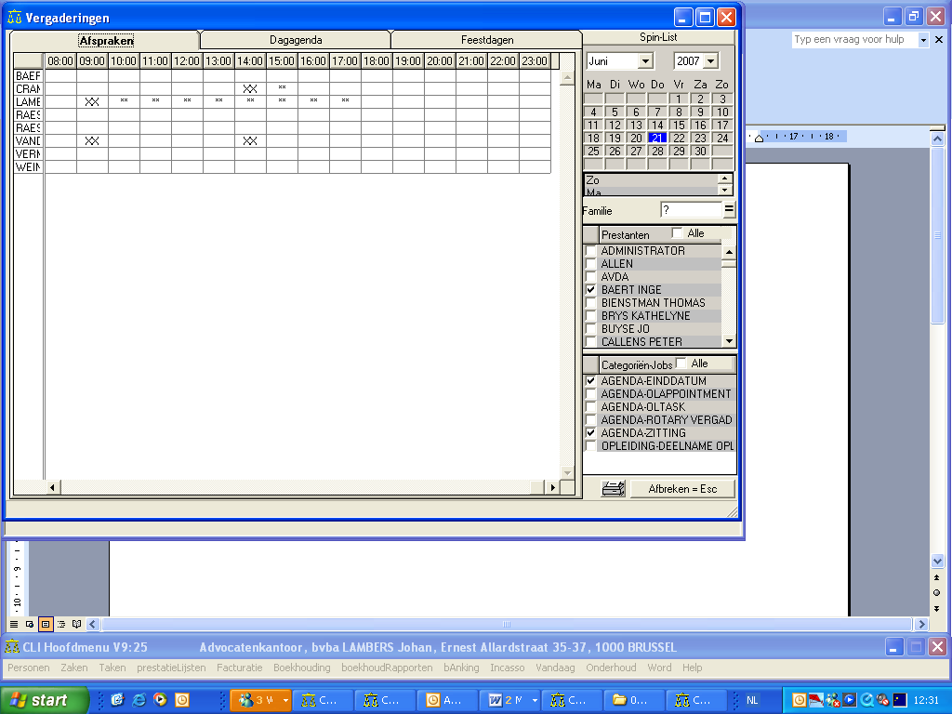
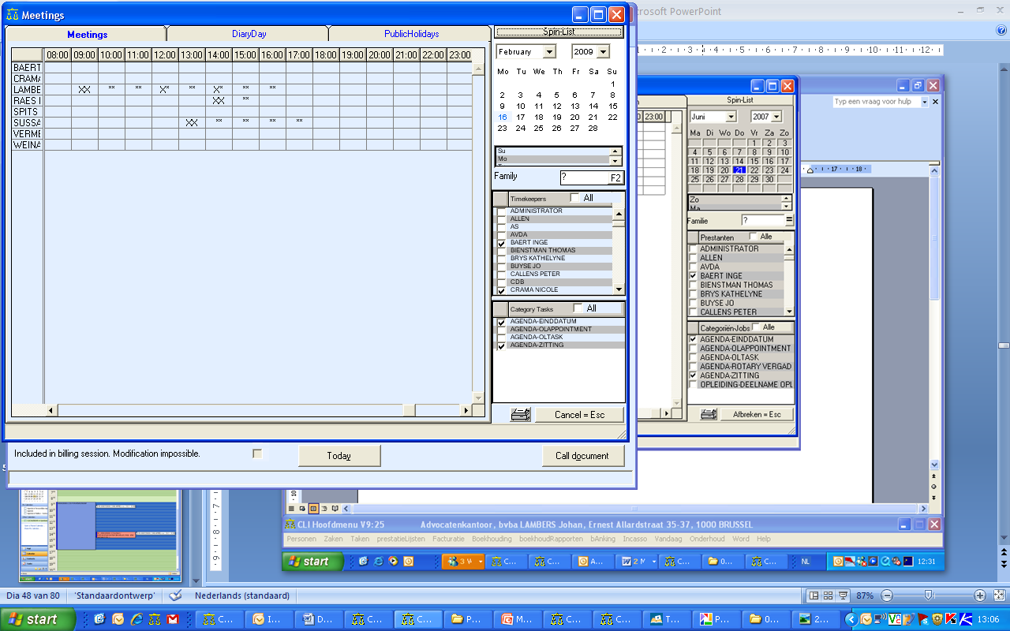
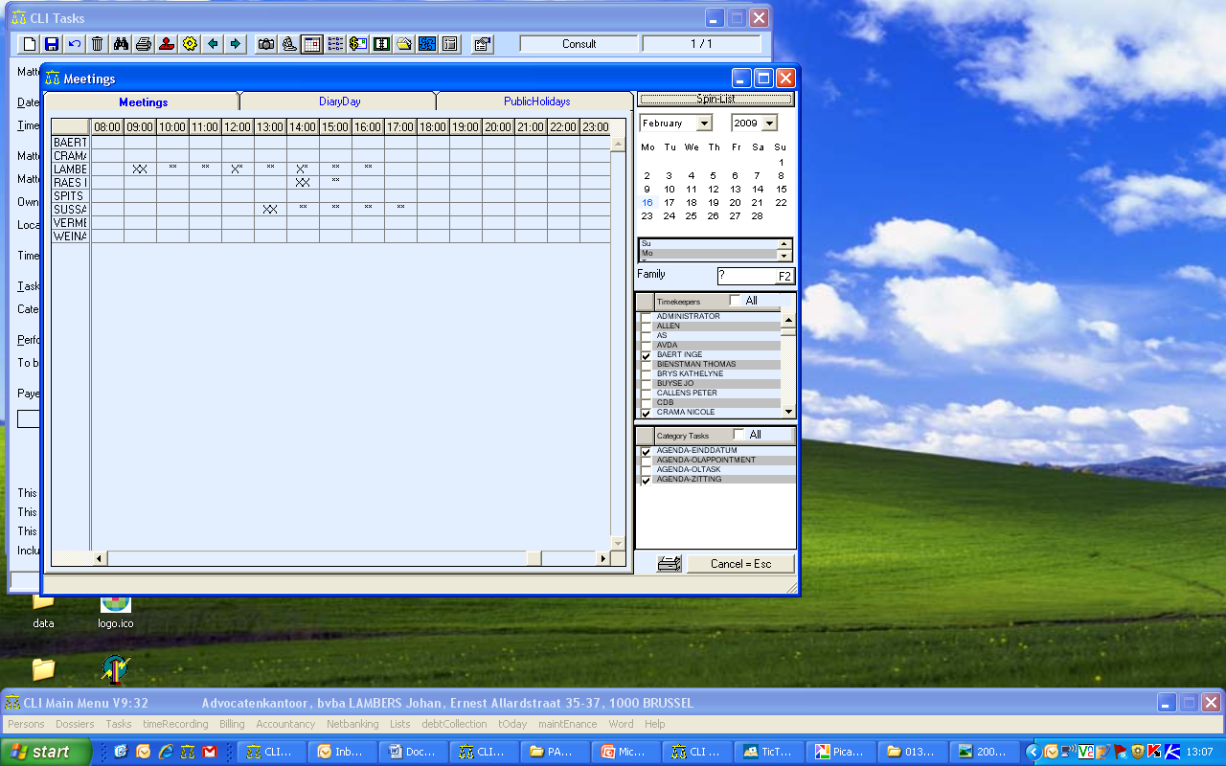

Slide 51
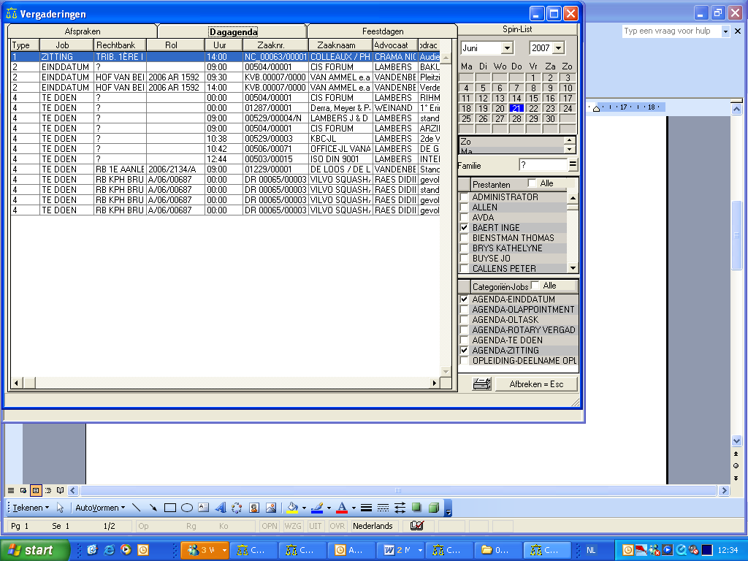
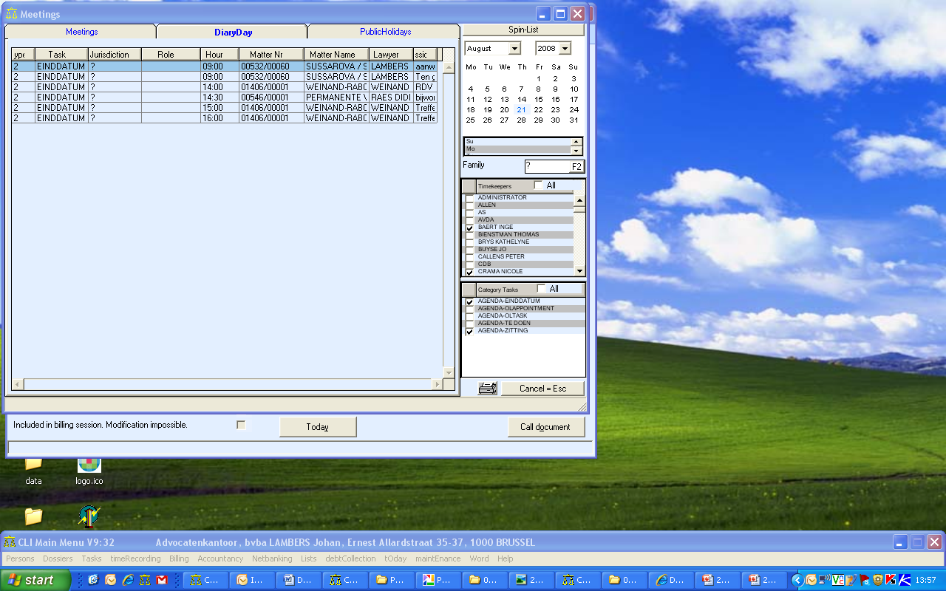

Slide 52
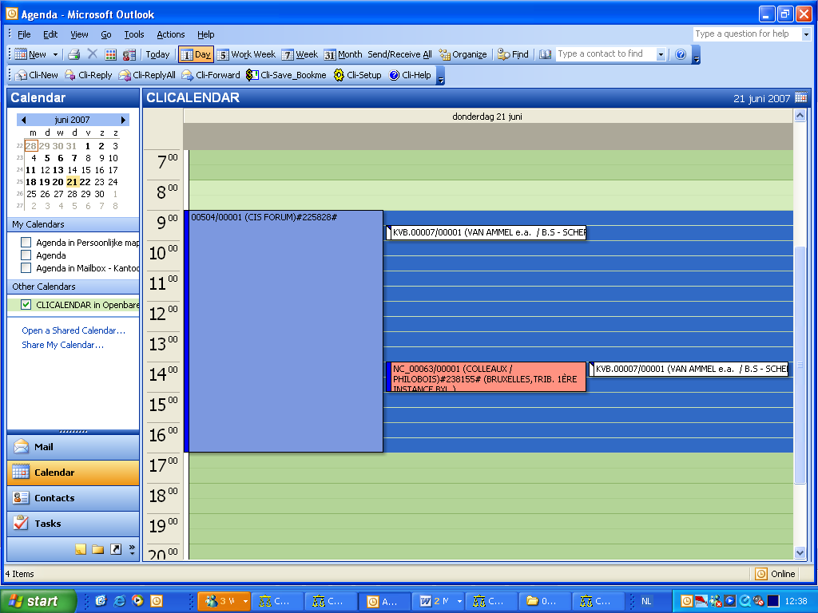

Slide 53
Improved legal research
links to relevant websites in files
use of on-line databases
Shared inhouse know - how

Slide 57
Exact accounting of time spent

Slide 58
Exact accounting of time spent

Slide 67
6.2.Communication
Use of e-mail with digital signature, availability through deviation of phone / mobile, use of phone over internet
Presentation of information : use of EXCEL-sheets, Power Point presentations

Slide 71
iustica.BE

Slide 74
6. 3. Results: law practice management
Reduced office space
Work at home or from anywhere = work at the office
Increased income per page of paper used
New gadgets ahead

Slide 75
Office space
Currently 320 m² of which 1/3 in reserve
2 workspaces in 12 to 24 m²
Plug-in system
Multifunctional projection room for meetings, workspace, library, etc.
Meetings outside the office with all access to all law practice data

Slide 76
Avenue Louise 109

Slide 77
NEW OFFICE SPACE IUSTICA.BE = 320 m²

Slide 78
TRADITIONAL LAW PRACTICE – DOCUMENT VOLUME
Filing cabinet: 198 cm (hight) х 43 cm (depth) х 120 cm (width)
1 filing cabinet = 5 depositors
1 depositor = 120 cm width
120 cm width * 5 depositors = Absolute filing space per filing cabinet = 600 cm
600 cm / 5.5 cm hight of one pack of Paper Din A4 = 109 packs of paper with each 500 pages
=> each file cabinet can hold 54‘500 pages

Slide 79
VIRTUAL LAW OFFICE = REDUCTION FILE CABINETS
Memory space used = 75 GB = 215’500 documents with different volume
1 page of text averages 75 Kb
75 GB / 75 Kb = 1‘050‘000 pages of text
1‘050‘000 pages of text / 54.500 pages in one file cabinet = reduction of 19,26 file cabinets

Slide 80
Increased revenue/ 500 A4 pages
2005: 6'035 € revenue per 500 A4 pages
2006: 8‘135 € revenue per 500 A4 pages
2007: 11’816 € revenue per 500 A4 pages
2008: 9’312 € revenue per 500 A4 pages
2009: 10’249 € revenue per 500 A4 pages

Slide 81
Gadgets to come
Possible equipment: voice recognition software
Server outside of the office
client’s access to file

Slide 82
CONCLUSIONS
The virtual office= paperless without exception
The virtual office = no way back
The virtual office and total quality management
The virtual office and the others: will they participate?

